Slide 1

Extrovert
Task
People
Introvert
Notes:
SHARE THIS SCREEN WITH THE PPT OPEN (NOT IN SLIDE SHOW MODE). CLICK ON THE NEXT SLIDES AND MOVE THE SYMBOLS AROUND ON THE SLIDE.

Slide 2




Four Symbols, three positions on the Map
Interests
Usual
Needs
Stress
Circle/Square are always together on the Map
Interests and Needs are hidden.

Slide 3
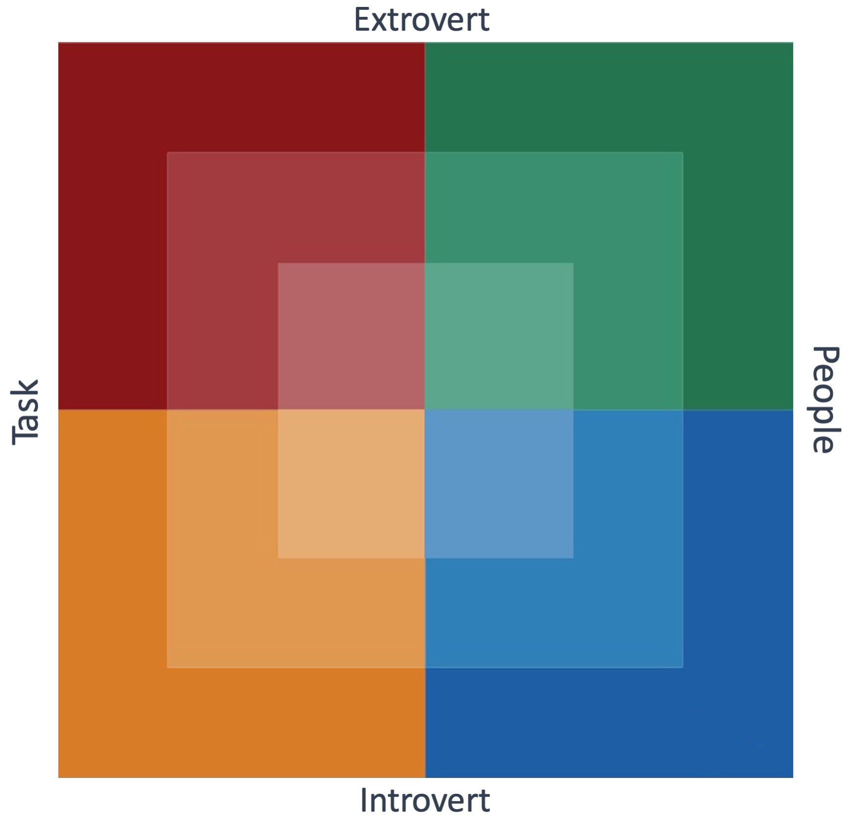


Slide 4

Interests
AA
BB
CC
DD
EE
FF
GG
HH
Notes:
Substitute initials of team members in text boxes AA, BB, CC, etc. Then drag initials to relative positions on the Map. Lead the team to dialogue about their INTERESTS the same as you would in a live Floor Exercise. Do the same for USUAL, NEEDS, and STRESS. IN ZOOM you can also use the ANNOTATE feature to allow each team member to write their own name where it appears on the Map.

Slide 5
Usual Style
AA
BB
CC
DD
EE
FF
GG
HH
Notes:
Substitute initials of team members in text boxes AA, BB, CC, etc. Then drag initials to relative positions on the Map. Lead the team to dialogue about their INTERESTS the same as you would in a live Floor Exercise. Do the same for USUAL, NEEDS, and STRESS.

Slide 6
Needs
Stress
AA
BB
CC
DD
EE
FF
GG
HH
Notes:
Substitute initials of team members in text boxes AA, BB, CC, etc. Then drag initials to relative positions on the Map. Lead the team to dialogue about their INTERESTS the same as you would in a live Floor Exercise. Do the same for USUAL, NEEDS, and STRESS.
NOTE that Needs and Stress are on the same slide because the Circle/Square are always in the same place on the Birkman Map.

Slide 7

Dotted
Diamond

Slide 8

Interests
Dotted
Diamond
Usual
Notes:
STOP THE PPT SHOW AND SHARE THE SCREEN WITH THE PPT OPEN FOR THIS SLIDE!
Click and drag the “Dotted Diamond” as you talk about a specific situation where there is no way to explain your behavior except by the presence of the Spirit working through you by the spiritual gifts. .

